Slide 1

VELLORE INSTITUTE OF TECHNOLOGY, CHENNAI
INNOVATIVE DESIGN PROJECT | BACSE291 | REVIEW REPORT II
Crypto-Agility Navigator
Dataflow-Aware Cryptographic Inventory and Prioritised Post-Quantum Migration
SUBMITTED BY
PROJECT GUIDE
Avi Dhandhania
25BCE1207
Dr. E Iniya Nehru
Faculty ID: 54128
SCOPE — School of Computer Science Engineering
Anmol Saluja
25BCE1332
Avika Tyagi
25BCE1294
BACSE291 | Review Report II
23 September 2026
Notes:
- Project name: Crypto-Agility Navigator.
- Course: BACSE291 — Innovative Design Project, Review Report II.
- Team: Avi Dhandhania, Anmol Saluja, Avika Tyagi.
- Guide: Dr. E Iniya Nehru, SCOPE, VIT Chennai.
- Milestone date: 22 September 2026.

Slide 2
CHAPTER 01
Introduction
The post-quantum deadline
HOW THE THREAT UNFOLDS
Shor’s algorithm renders RSA, ECDSA, ECDH and Ed25519 breakable on a Cryptographically Relevant Quantum Computer (CRQC). NIST has finalised the replacements: FIPS 203 (ML-KEM), FIPS 204 (ML-DSA) and FIPS 205 (SLH-DSA). What to migrate to is settled; the open problem is locating and sequencing the migration.
Quantum computer arrives
Shor’s algorithm breaks RSA / ECDSA / ECDH
↓
The HNDL threat
Today’s ciphertext is decrypted
A passive adversary stores encrypted traffic today at near-zero cost, intending to decrypt it once a CRQC exists. Forward secrecy cannot protect data retroactively — detection after the fact provides no remedy.
Harvest-Now, Decrypt-Later (HNDL)
↓
Mosca’s inequality
Long-lived data is exposed
A data path is already breached when x + y > z, where x = confidentiality lifetime, y = migration duration, z = CRQC horizon. Critically, x is a property of the data, not of the cipher.
Financial, medical, identity records
↓
REGULATORY URGENCY:
Migration cannot be sequenced
INDIA CII 2027–2029
RBI Q-SAFE
SEBI CSCRF
US EO 14412
Existing scanners report flat lists — no priority
02 / 10
Notes:
- Open with the CRQC deadline and NIST FIPS 203 / 204 / 205.
- Explain why HNDL matters today — stored ciphertext is a future breach.
- Walk Mosca’s inequality and stress x is data, not cipher.
- Tie regulatory drivers (India CII, RBI, SEBI, US EO) to urgency.
- End by setting up why existing scanners fail to prioritise.

Slide 3
CHAPTER 02
Literature Survey
Sixteen papers surveyed across ACM Digital Library, IEEE Xplore, IACR ePrint, arXiv and Springer — Jan 2024 to Aug 2026.
SOURCES 5
PAPERS 16
SPAN JAN 2024 – AUG 2026
ID | Authors / Year | Focus | Limitation
P1 | Näther & Hirsch, 2026 | 214-rule static scanner; CBOM export | Real-world precision ≈ 0.30; no dataflow; no prioritisation
P2 | Shaw, 2026 | Quantum-aware VQE scoring (0–10) | Algorithm-intrinsic — every RSA-2048 site scores the same
P3 | Pallarés et al., 2026 | LLM-based fragment migration | Synthetic snippets; round-trip verification can pass on downgrade
P5 | Costa, 2026 | CARS composite readiness index | One score per repo; not actionable for sprints
P6 | IBM Research, 2026 | CBOM object model (CycloneDX 1.6) | No fields for data lifetime, exposure or HNDL risk
P13 | Rahaman et al., 2019 | CryptoGuard inter-procedural taint | Targets classical misuse; no PQC awareness
Full P1–P16 matrix in report Section 2.2. Citation chasing identified 11 papers from 2025–26, 3 from 2024, 2 foundational baselines (2017, 2019).
03 / 10
Notes:
- Survey scope: 5 sources, 16 papers, Jan 2024 – Aug 2026.
- P1 (Näther & Hirsch) is our closest baseline — static, low precision, no dataflow.
- P2 / P3 / P5 / P6 are the most-cited prior works we critique.
- P13 (CryptoGuard) is the foundational taint baseline from 2019.
- Full P1–P16 matrix lives in written report Section 2.2.

Slide 4
CHAPTER 03 — PART 1 OF 2
Challenges in Current Tooling
Existing cryptographic inventory scanners produce semantically flat output. Five measurable problems follow.
01
02
03
04
05
Findings are noise
Flat scoring
No dataflow
Runtime-arg blindness
No migration order
Crypsy achieves real-world actionable precision of only 0.30 — over two-thirds of reported calls are non-security hashing matched by the same heuristic rules.
Where risk scores exist they depend only on the algorithm. Every RSA-2048 site receives an identical value, giving no signal for sequencing.
Scanners report RSA-2048 call sites with no notion of what data is being protected or for how long.
Arguments computed at runtime cannot be resolved. Crypsy recall is 0.66 — roughly one-third of assets are missed.
Engineering teams receive hundreds of unordered findings with no defensible priority order and no path to a multi-year roadmap.
→
→
→
→
Net effect — an organisation cannot migrate what it cannot locate, and cannot sequence what it cannot score.
≈ 0.30
≈ 0.66
0
Real-world actionable precision of current scanners (Crypsy baseline)
Recall ceiling — one-third of cryptographic assets are missed
Tools today that score data paths by retention and exposure
04 / 10
Notes:
- Walk through each of the five challenges in order, left to right.
- Emphasise precision 0.30 (C1) and flat scoring (C2) as the two most damaging problems.
- Card 5 is filled to flag the synthesis gap this project addresses.
- Net-effect line is the takeaway: locate → score → sequence.
- Crypsy recall 0.66 (C4) and no-dataflow (C3) round out the gap analysis.

Slide 5
CHAPTER 03 — PART 2 OF 2
Research Gap & Five Pillars of Novelty
No prior tool combines dataflow-aware scoring with verified hybrid patch synthesis. We identify five unresolved gaps (N1–N5).
Capability | P1 | P2 | P3 | P5 | P6/P7 | Ours
Multi-language discovery | ✔ | ◐ | ✘ | ◐ | ✘ | ✔
CycloneDX 1.6 CBOM output | ✔ | ✘ | ✘ | ✘ | ✔ | ✔
Dataflow to protected data (N1) | ✘ | ✘ | ✘ | ✘ | ✘ | ✔
Retention-lifetime inference | ✘ | ✘ | ✘ | ✘ | ✘ | ✔
Call-site-varying risk (N2) | ✘ | ✘ | ✘ | ✘ | ✘ | ✔
Ranking eval nDCG / τ (N2) | ✘ | ✘ | ✘ | ✘ | ✘ | ✔
Context noise suppression (N3) | ✘ | ◐ | ✘ | ✘ | ◐ | ✔
Verified hybrid patches (N4) | ✘ | ✘ | ✘ | ✘ | ✘ | ✔
Public annotated benchmark (N5) | ✘ | ✘ | ✘ | ✘ | ✘ | ✔
FIVE PILLARS OF NOVELTY
N1
Retention-aware dataflow binding
First framework to bind cryptographic call sites to data-confidentiality lifetimes extracted from declarative configuration.
N2
Call-site-discriminating risk score
Scores data paths rather than algorithms; evaluated against expert priority order with nDCG@20 and Kendall-τ.
N3
Dataflow-conditioned noise suppression
Reclassifies non-security hashes (cache keys, ETags, checksums) from source/sink provenance without manual triage.
N4
Differentially verified hybrid patches
Three-gate harness: differential testing, property tests, downgrade-resistance checks.
N5
Public retention-annotated benchmark
First open dataset pairing real cryptographic call sites with retention ground truth and expert priority rankings.
✔ fully present · ◐ partial / limited · ✘ absent
05 / 10
Notes:
- Every capability in the rightmost column is unique to this work.
- N1 (retention-aware dataflow) and N2 (call-site risk score) are the most consequential gaps.
- P1 is strong on discovery and CBOM output but covers nothing below row 2.
- N3 has partial coverage in P2 and P6/P7 — no prior tool fully solves noise suppression.
- N5 is the open-dataset contribution; no prior tool ships a retention-annotated benchmark.

Slide 6
CHAPTER 04
Project Objectives
O1
PRIMARY
O2
PRIMARY
O3
PRIMARY
O4
PRIMARY
Multi-language discovery
Semantic dataflow binding
HNDL exposure scoring
Noise suppression
AST-based discovery engine emitting standard CycloneDX 1.6 CBOM for Python and Java.
Inter-procedural analysis binding each call site to plaintext source, sink and retention evidence.
Data-path-dependent score operationalising Mosca’s inequality for prioritisation.
Filter non-security cryptographic operations using dataflow context.
Target: F₁ ≥ 0.85 (Crypsy 0.75; CBOMkit 0.66)
Target: ≥ 70% call-site binding; ≥ 50% retention extraction
Target: nDCG@20 ≥ 0.80; Kendall-τ ≥ 0.60
Target: actionable precision ≥ 0.70 (baseline ≈ 0.30)
O5
PRIMARY
O6
SECONDARY
O7
SECONDARY
SCOPE
Verified hybrid patch synthesis
Public benchmark release
Evaluation methodology
From discovery to verified hybrid patches
Hybrid PQC patches (X25519 + ML-KEM) verified by differential testing before PR emission.
Retention-annotated cryptographic benchmark with expert priority orders.
Standardise the ranking-evaluation protocol for migration tooling.
Seven objectives trace to five novelty pillars (N1–N5) and deliver a complete, auditable post-quantum migration pipeline.
Target: ≥ 80% pass rate on real multi-file repos
Target: 15–20 real-world repositories
Target: documented, reproducible protocol
06 / 10
Notes:
- Every objective carries a measurable target — no soft goals.
- O1–O5 are the primary technical objectives; O6–O7 are research-community objectives.
- O4 directly answers the 0.30 precision problem from slide 5.
- O5’s ≥80% patch pass-rate target is the hardest to hit.
- O6 ships the public benchmark that N5 on slide 6 calls for.

Slide 7
CHAPTER 05 — PART 1 OF 2
Proposed Methodology
A four-stage pipeline. Each stage consumes the structured output of the previous stage and can be evaluated independently.
STAGE 01
STAGE 02
STAGE 03
STAGE 04
Multi-Language Cryptographic Discovery
Inter-Procedural Dataflow & Retention Engine
HNDL Scoring & Noise Suppression
Hybrid Patch Synthesis & Verification
• Tree-sitter + Python ast parsers
• Rule corpus (cryptography.hazmat, hashlib, PyCryptodome, JCA, Bouncy Castle)
• Constant propagation for runtime‑resolved algorithms
• Backward taint: arg → source (DB, file, RNG)
• Forward taint: output → sink (S3, Redis, socket)
• Declarative retention extractor (S3 lifecycle, cache TTL, ORM)
• Exposure(p) = wᵣ·R × wₑ·E × wₐ·A × wₖ·K
• Mosca breach: x + y > z
• Reclassify non-security hashing
• X25519 + ML-KEM-768 via liboqs
• Gate 1: differential equivalence
• Gate 2: property tests
• Gate 3: downgrade resistance
→
→
→
OUTPUT → cryptoProperties
OUTPUT → dataflowProperties
OUTPUT → ranked risk backlog
OUTPUT → verified hybrid PRs
Design principle
Each stage is independently useful — discovery, binding and prioritisation remain valuable even if patch synthesis slips.
07 / 10
Notes:
- Pipeline is modular — each stage produces a structured artifact.
- Stages 1–3 are independently useful; Stage 4 is the most exploratory.
- Stage 4 is gated by three independent verification checks.
- Discovery and binding still deliver value if patch synthesis slips.

Slide 8
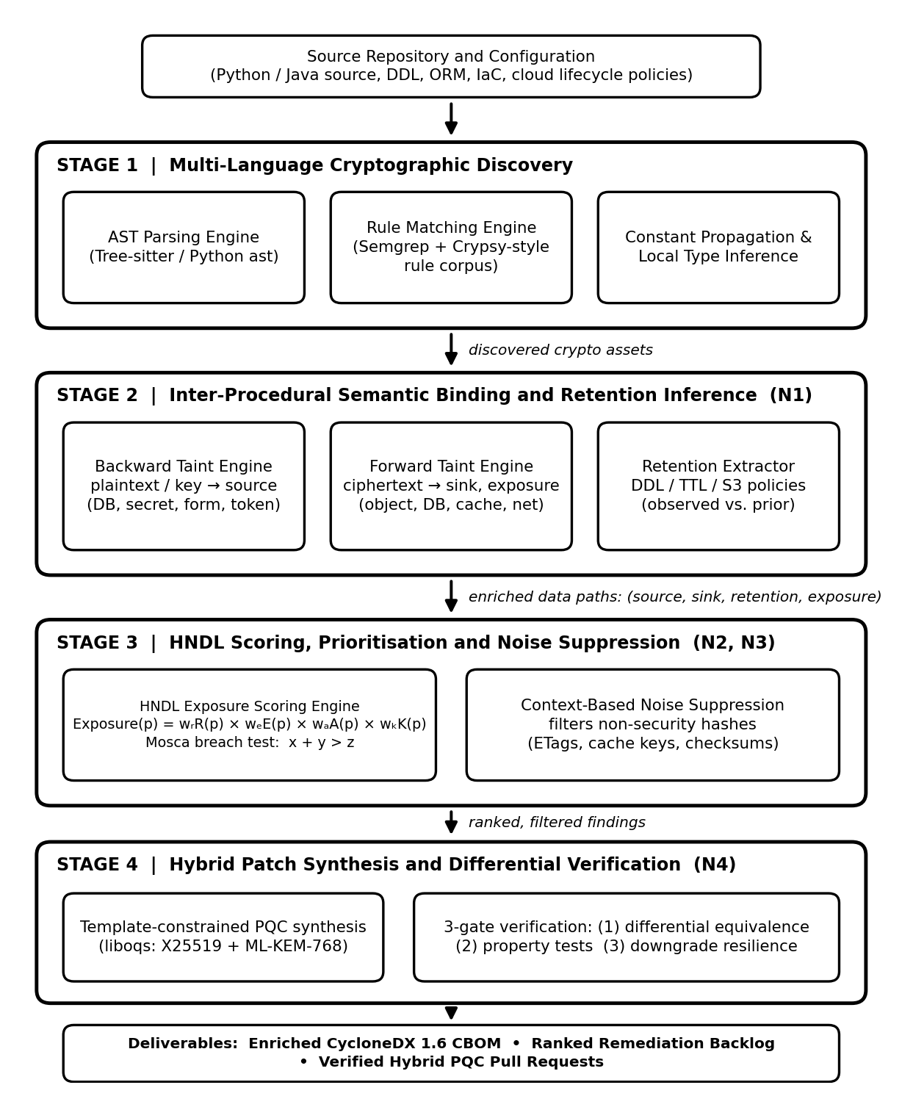
CHAPTER 05 — PART 2 OF 2
System Architecture
CBOM EXTENSION
CycloneDX 1.6 + dataflowProperties
cryptoproperties
Standard algorithm attributes, key sizes, classical security level and NIST quantum security level.
dataflowproperties
Plaintext source, ciphertext sink, retention evidence (years, type, observed flag), exposure surface and HNDL risk assessment (score, urgency tier, Mosca-breach flag).
auditproperties
Provenance flag (observed vs inferred), scan timestamp, tool version and insufficient-context bucket for unresolved dataflow paths.
Schema-conformant JSON / XML. Compatible with OWASP CycloneDX 1.6 validators.
08 / 10
Notes:
- Four subsystems map 1:1 to the four pipeline stages.
- The CBOM is the audit artifact consumed downstream.
- dataflowProperties is the novel extension beyond standard CBOM.
- Lattice ordering enables partial-order comparison of risk states.

Slide 9
CHAPTER 06
Results — Initial Implementation
TRL 3 proof-of-concept (≈ 20% implementation). Working Stage 1–3 pipeline, CLI, REST API, web dashboard and CycloneDX 1.6 CBOM generator.
8 / 8
33.33
33.3%
Unit tests passing across all pipeline stages
HNDL score — archive.py (CRITICAL_IMMEDIATE, Mosca breach)
Noise filtered — non-security SHA-256 correctly suppressed
BENCHMARK PROJECT — EXAMPLES/SAMPLE_PROJECT/
Rank | Call site | Algorithm | Retention | Score | Urgency
1 | archive.py:11 | RSA-OAEP 2048-bit | 10.0 y (S3 lifecycle) | 33.33 | CRITICAL_IMMEDIATE (Mosca breach: 10 + 2 > 7)
2 | session.py:11 | RSA-OAEP 2048-bit | ≈ 0.00003 y (Redis TTL) | 0.00 | LOW (no breach)
3 | etags.py:9 | SHA-256 256-bit | ≈ 0.00011 y | 0.00 | SUPPRESSED (non-security hash)
Two identical RSA-2048 call sites separated by 33.33 score points — the behaviour claimed as N1, N2 and N3.
IMPLEMENTED MODULES (1,335 LOC)
NEXT MILESTONES (REVIEW III – IV)
discovery.py
dataflow.py
scorer.py
cbom.py
cli.py
server.py
web/
Java support
Cross-module taint
Patch synthesis harness
nDCG / Kendall-τ eval
tests/
09 / 10
Notes:
- 20% implementation milestone reached — TRL 3 proof-of-concept.
- Identical RSA-2048 primitives separated by 33.33 points proves N1+N2+N3.
- All 8 unit tests pass in 0.026s.
- Non-security SHA-256 correctly suppressed — noise filter works.
- Next milestones: Java support, cross-module taint, patch harness, ranking eval.

Slide 10
BACSE291 | REVIEW REPORT II
Thank You
Crypto-Agility Navigator — Dataflow-Aware Cryptographic Inventory and Prioritised Post-Quantum Migration
Questions & Discussion
TEAM
PROJECT GUIDE
Avi Dhandhania
Dr. E Iniya Nehru
25BCE1207
Faculty ID: 54128
Anmol Saluja
SCOPE, VIT Chennai
25BCE1332
Avika Tyagi
25BCE1294
BACSE291 | Review Report II
10 / 10
Notes:
- Thank the panel for their time and attention.
- Acknowledge the guide, Dr. E Iniya Nehru, and the panel members.
- Invite questions on methodology, architecture, or evaluation plan.
- Be ready to discuss the Review III roadmap (Java support, cross-module taint, patch harness).

